Slide 1
Business Ethics, 3e Chapter 12: Global Sustainability

Slide 2
Economic Growth and the World’s Changing Climate (1 of 8)
Businesses and governments obligated to reverse projections on climate change.
Solutions need to consider the costs.
Notes:
12.1 Describe how fossil fuel economies impact the Earth’s climate and human well-being.
Sustainability Defined by John Ehrenfeld as “the possibility that humans and other life will flourish on Earth forever.”
A simplistic ethical solution to the long-term problem is that businesses and governments are obligated to do whatever is necessary to reverse the disturbing projections, and those businesses and nations that contributed the most to the problem bear the greatest burden in fixing it.
From a business and economics perspective, climate change solutions need to take into consideration costs associated with correcting the problem and constraints the solutions have on economic development.

Slide 3
Economic Growth and the World’s Changing Climate (2 of 8)
Economic Growth
Population growth triggered need for more energy.
Fossil fuel technology have created environmental problems.
Notes:
12.1 Describe how fossil fuel economies impact the Earth’s climate and human well-being.
As the number of people inhabiting the Earth increased, more energy was needed to produce more products used by more consumers.
Over time, fossil fuel–based technologies have created environmental problems, such as air, water, and soil pollution.
For two centuries, people did not realize that economic growth through fossil fuel–based industrialization also impacted the Earth’s climate.

Slide 4
Economic Growth and the World’s Changing Climate (3 of 8)
Climate Change
NASA’s monitoring of temperature and “vital signs.”
Primary human contribution: CO₂
97% of climate scientists agree warming trends due to human activity.
Notes:
12.1 Describe how fossil fuel economies impact the Earth’s climate and human well-being.
Climate change A long-term change in the Earth’s average atmospheric temperature.
Using sophisticated databases and computers, the National Aeronautics and Space Administration (NASA), which monitors weather patterns, has documented a 1.9°F (0.95°C) global temperature increase from 1880 to 2020, with a steady rise since 1910.
Besides taking the Earth’s temperature every year, NASA closely monitors four other “vital signs,” a health dashboard for the Earth: arctic ice, land ice, sea levels, and carbon dioxide.
Artic ice has declined at a rate of 12.85% per decade relative to the 1981–2010 average.
Land ice in Antarctica has declined 146 metric gigatons per year from 2002 to 2020, and 281 metric gigatons annually in Greenland.
Sea levels are rising 3.3 millimeters per year, which is 7 inches in the past 100 years.
Carbon dioxide in the atmosphere has increased 9% from 2005 to 2020, 0.6% annually, and 47% since 1880.
The primary human contribution to GHG is CO₂ emitted from burning conventional fossil fuels used for energy production (e.g., coal, oil, and natural gas).
Prior to the Industrial Revolution, the volume of CO₂ atmospheric concentrations was a consistent 280 parts per million (ppm).
By 2020, reliance on fossil fuel as an energy source increased CO₂ atmospheric concentrations to more than 413 ppm, at an annual rate of 1.5% over the preceding decade
NASA reports that “97 percent or more of actively publishing climate scientists agree: Climate-warming trends over the past century are extremely likely due to human activities [and] most of the leading scientific organizations worldwide have issued public statements endorsing this position.”
A handful of scientists, however, maintain that continual record-high temperatures do not prove that global warming is occurring or attributable to CO₂ emissions.

Slide 5
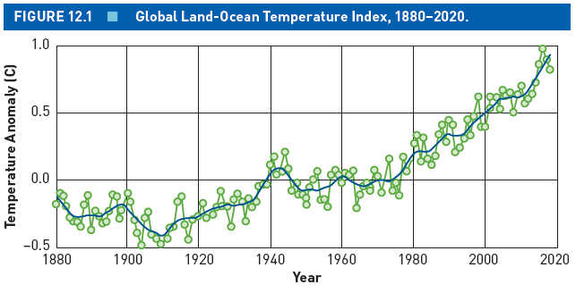
Economic Growth and the World’s Changing Climate (4 of 8)
Notes:
12.1 Describe how fossil fuel economies impact the Earth’s climate and human well-being.
Figure 12.1 Global Land-Ocean Temperature Index, 1880–2020

Slide 6
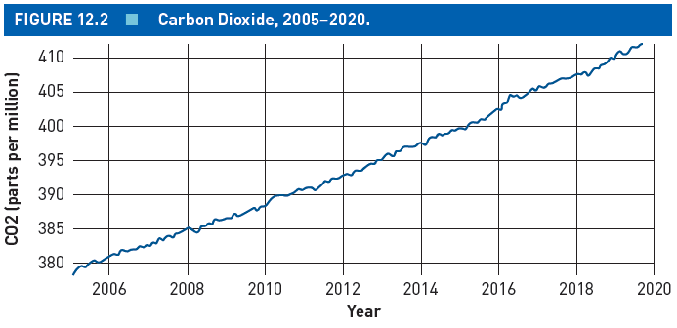
Economic Growth and the World’s Changing Climate (5 of 8)
Notes:
12.1 Describe how fossil fuel economies impact the Earth’s climate and human well-being.
Figure 12.2 Carbon Dioxide, 2005–2020

Slide 7
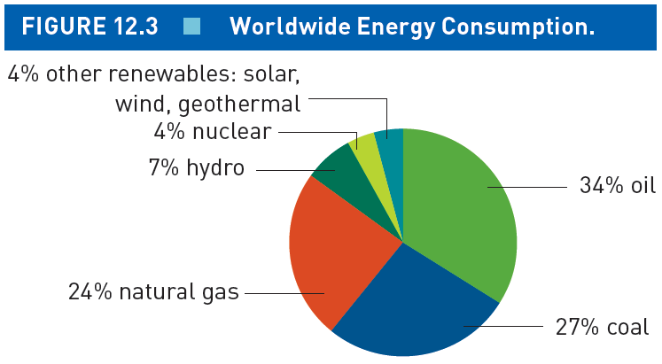
Economic Growth and the World’s Changing Climate (6 of 8)
Notes:
12.1 Describe how fossil fuel economies impact the Earth’s climate and human well-being.
Figure 12.3 Worldwide Energy Consumption

Slide 8
Economic Growth and the World’s Changing Climate (7 of 8)
Climate Change Impacts
Increased natural disasters.
Businesses must address climate change in risk assessments.
Governmental reports on negative impacts.
Notes:
12.1 Describe how fossil fuel economies impact the Earth’s climate and human well-being.
Droughts and heat waves occur more often, and hurricanes are stronger and more intense, which negatively impact business and economic systems.
Poorer nations are particularly vulnerable because they are least equipped to manage climate change impacts.
In the United States, the altered climate change weather patterns have resulted in the loss of lives and damaged regional economies and the financial system.
Businesses must now address climate change issues in their risk management assessments.
A political bipartisan report, “Risky Business: The Economic Risks of Climate Change in the United States,” quantifies the economic risks from the impacts of a changing climate.
The Centers for Disease Control and Prevention links specific climate change issues with a host of health issues, including heart problems, asthma, cancer, trauma, stress-related disorders, diseases, and death.

Slide 9
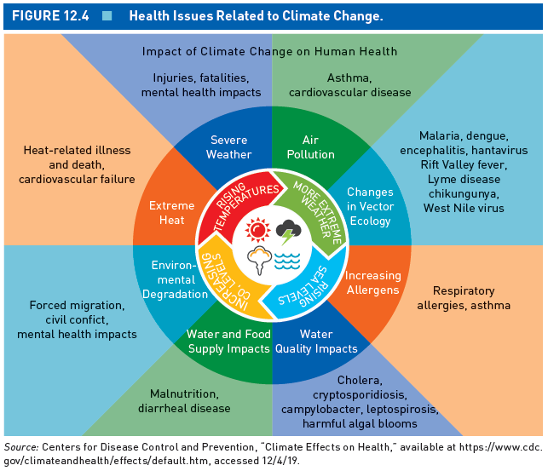
Economic Growth and the World’s Changing Climate (8 of 8)
Notes:
12.1 Describe how fossil fuel economies impact the Earth’s climate and human well-being.
Figure 12.4 Health Issues Related to Climate Change
Source: Centers for Disease Control and Prevention, “Climate Effects on Health,” available at https://www.cdc.gov/climateandhealth/effects/default.htm, accessed 12/4/19.

Slide 10
International Treatises and National Public Policy (1 of 4)
 | 1990 | 2018 | % Emissions Change
World | 22,637* | 37,887 | 67%
China | 2,397 (11%) | 11,255 (30%) | 423%
United States | 5,063 (22%) | 5,275 (14%) | 4%
European Union–28 | 4,408 (19%) | 3,457 (9%) | -22%
India | 594 (3%) | 2,621 (7%) | 341%
Russia | 2,355 (10%) | 1,748 (5%) | -26%
Notes:
12.2 Explain the 2015 Paris Agreement goals and how the three largest carbon dioxide–emitting countries have responded.
Table 12.1: CO₂ Emissions From Fuel Consumption, 1990–2018
* Unit: Million tonnes of CO₂
Source: ©European Union.

Slide 11
International Treatises and National Public Policy (2 of 4)
Global CO₂ Emissions
Environmental conditions will worsen under “business as usual” conditions.
Americum unit of analysis.
Notes:
12.2 Explain the 2015 Paris Agreement goals and how the three largest carbon dioxide–emitting countries have responded.
As underdeveloped nations climb out of poverty and malnourishment, and developed nations seek to enhance their standards of living, environmental conditions will worsen under “business as usual” conditions.
Journalist Thomas Friedman puts population growth impacts in perspective using an Americum unit of analysis.
Americum Any group of 350 million people living an American lifestyle.

Slide 12
International Treatises and National Public Policy (3 of 4)
Global Accountability and Cooperation
Kyoto Protocol.
Paris Agreement.
United Nations Environment Programme annual report.
Notes:
12.2 Explain the 2015 Paris Agreement goals and how the three largest carbon dioxide–emitting countries have responded.
Kyoto Protocol A treaty established in 1997 at a climate change conference in Japan to reduce worldwide GHG gas emissions to 5% below the 1990 level by 2012.
Ratified by more than 180 nations, the Kyoto Protocol went into effect in 2005 without the consent of the United States.
Paris Agreement The first international climate agreement binding on both developed and developing countries, with a goal to limit average global temperature increases to 1.5°C of preindustrial levels.
The United Nations Environment Programme produces an annual report assessing the gap between Paris Agreement goals and progress made to date.

Slide 13
International Treatises and National Public Policy (4 of 4)
Global Accountability and Cooperation: Responses to Paris Agreement
China: low-carbon cities and emissions trading system.
EU: 40% GHG emission reduction.
United States: inconsistent.
Notes:
12.2 Explain the 2015 Paris Agreement goals and how the three largest carbon dioxide–emitting countries have responded.
China’s strategies include higher energy efficiency standards; low-carbon cities required to develop CO₂ emissions baselines and targets; and a national emissions trading system (ETS) among companies, institutions, and governments based on continuously declining allotted emission amounts.
Emissions trading system A system that allows low-carbon organizations to sell unused pollution permits to high-carbon organizations needing extra pollution permits.
The EU submitted a Paris Agreement plan to reduce GHG emission 40% by 2030 compared to 1990 levels.
The U.S. reaction has been less consistent.
Democratic president Barack Obama developed more restrictive rules for factories and power plants, and established higher energy efficiency standards for appliances, cars, and trucks.
Upon President Donald Trump’s election in 2016, his administration rolled back many Obama regulatory actions because of their negative impacts on business activities and job creation.
In response to the federal government’s withdrawal, U.S. states and cities formed associations that adopted Paris Agreement goals.
A group led by influential Republicans from previous presidential administrations formed the Climate Leadership Council (CLC).

Slide 14
Competitive Advantages of Green Businesses (1 of 4)
4 business environmental responses.
5 factors in favor of superior environmental performance.
Shareholders reward sustainability efforts.
Notes:
12.3 Articulate the competitive advantages of being eco-friendly.
Business environmental responses can be categorized as one of the following:
Eco-resistant: Hostile toward environmental regulations and science
Eco-compliant: Accept and follow the law
Eco-efficient: Reduce energy, waste, and scrap costs
Eco-advantage: Green leadership, innovation, products, and services
The business case for superior environmental performance is based on five factors: (1) revenue generation, (2) cost reductions, (3) mitigating risks, (4) employee relations benefits, and (5) community relations (see Table 12.2).
As climate change issues gain greater public awareness, shareholders are awarding sustainability efforts.
The Morgan Stanley Capital International (MSCI) World Index measures the market performance of large and midcap companies that have a global presence.
The stock for companies that were the subject of positive climate change news, and made positive environmental announcements, outperformed the MSCI World Index by 15%.
The stock for companies that had more positive press and company environmental announcements over the preceding 12 months outperformed the MSCI World Index by 26%.
The stock for companies that received negative climate change news underperformed the MSCI World Index by 5%.

Slide 15
Competitive Advantages of Green Businesses (2 of 4)
Competitive Advantages of Being Eco-Friendly
Revenue Generation
Cost Savings
Mitigating Risks
Employee Relations Benefits
Community Relations
Notes:
12.3 Articulate the competitive advantages of being eco-friendly.
Table 12.2: Competitive Advantages of Being Eco-Friendly
Revenue Generation
Product differentiation through eco-labeling.
New markets for green products and producing green technologies.
Customers with higher environmental expectations develop greater loyalty to products.
Qualifying for green and socially responsible mutual funds provides easier access to capital.
Cost Savings
Reduction in escalating energy costs.
Reduction in supply chain and distribution costs.
Lower insurance premiums for sustainable development initiatives.
Lower sustainability-linked bank loans for projects and acquisitions that reduce environmental risk.
Reduction in costs associated with environmental clean-ups and property damage.
Avoidance of regulatory delays in bringing new products to market.
Greater regulatory flexibility for organizations with an environmental management system.
Mitigating Risks
Stay ahead of regulatory developments.
Avoid potential legal liabilities.
Avoid damage to reputation and brand.
Avoid supply chain disruptions and shocks.
Employee Relations Benefits
Millennials and other professionals consider environmental reputation when searching for jobs.
Employees are proud to be associated with the organization.
Enhances employee commitment and performance.
Community Relations
Media outlets highlight the organization as a good citizen.
Community members are more accepting of organizational expansion.
Community activists are more willing to engage in discussions.

Slide 16
Competitive Advantages of Green Businesses (3 of 4)
Environmental, Social, and Governance (ESG) market
Dow Jones Sustainability Index.
Consumer spending for eco-friendly products.
Notes:
12.3 Articulate the competitive advantages of being eco-friendly.
The competitive advantages of businesses adopting an eco-friendly perspective is reflected in the growth of the Socially Responsible Investing (SRI) market, also referred to as the Environmental, Social, and Governance (ESG) market.
Dow Jones Sustainability Index An index, created in 1999, that consists of the leading publicly owned sustainable companies based on their corporate economic, environmental, and social performance.
Consumer spending for eco-friendly products continues to increase substantially, as does the number of sustainably certified products available.

Slide 17
Competitive Advantages of Green Businesses (4 of 4)
Positive media attention for green accomplishments.
Increasing demands for leadership action.
Notes:
12.3 Articulate the competitive advantages of being eco-friendly.
The media is particularly fond of highlighting green accomplishments.
Increasingly, employees and the public are demanding leadership action.
At Amazon, 3,000 employees, led by “Amazon Employees for Climate Justice,” walked out of its Seattle headquarters, as did 1,800 other Amazon employees in more than 25 cities and 14 countries.
The group made three specific company demands:
Stop donating to politicians and lobbying groups that deny the reality of climate change.
Stop working with oil and gas companies that optimize fossil fuel extraction.
Achieve zero carbon emissions by 2030.

Slide 18
Business Sector Responses (1 of 2)
Green Energy, Technology, and Jobs
Project Drawdown: 7 categories of solutions.
Renewable energy: solar, wind, geothermal, hydro, and biomass.
Preference for wind and solar.
Notes:
12.4 Identify big-impact greenhouse gas reduction solutions and science-based targets.
Project Drawdown Ranks the impact of sustainability solutions based on their projected global GHG reductions by 2050.
The solutions are grouped in seven areas: energy, food, women and girls, buildings and cities, land use, transportation, and coming attractions.
Renewable energy Natural processes continuously replenished by nature at a higher rate than they are consumed.
Solar, wind, geothermal, hydro, and biomass are the primary sources of renewable energy.
According to the Union of Concerned Scientists, wind and solar are the preferred renewable energy sources.

Slide 19
Business Sector Responses (2 of 2)
Science-Based Firms
Scope 1, 2, and 3 GHG emissions.
Walmart: first large retailer to sign on.
Clean energy technology can lead to failure: Better Place
Notes:
12.4 Identify big-impact greenhouse gas reduction solutions and science-based targets.
A key accomplishment of the 2015 Paris Agreement was the establishment of science-based targets for companies to reduce their GHG emissions in alignment with Paris Agreement goals to limit global warming to 1.5°C above preindustrial levels.
Science-based firms take responsibility for three types of GHG emission scopes that are publicly announced and validated:
Scope 1 consists of direct GHG emissions from owned or controlled sources, such as on-site fossil fuel combustion and fleet fuel consumption.
Scope 2 is indirect GHG emissions from energy purchased by the company, such as from a public utility.
Scope 3 is indirect emissions attributed to the company’s value chain, both upstream supplier emissions and downstream consumer emissions, accounting for both their own purchases and the products they sell.
Developing new clean energy technologies can also lead to gigantic financial failures.
Shai Agassi, CEO of Better Place, developed a system for drivers to pull into a station and swap batteries in a few minutes, the same amount of time it takes to refuel gasoline, rather than wait for them to be recharged.
In 2008, Better Place projected 100,000 battery swap electric cars on Israeli roads within a few years, coinciding with rollouts in other nations.
After 5 years of operation, the start-up went bankrupt, having spent about $1 billion to sell or lease 1,200 electric vehicles with battery swap capacities.

Slide 20
Managing the Environmental Change Process
Create a “Green Team”
Elicit ideas from employees.
10 steps to follow.
Example: Edgewood College.
Notes:
12.5 Summarize 10 aspects of the environmental change process.
Green team A team of employees (go-getters) who address common sustainability concerns, share knowledge, and successfully implement environmental action plans.
The green team should elicit change ideas from employees, industry best practices, government programs, and other sources.
The green team should determine which improvement areas are easy to measure and impact.
Step 1: Create a green team accountable to a specific high-level manager.
Step 2: Give credit for previous accomplishments.
Step 3: Gather relevant data and create historical benchmarks.
Step 4: Engage employees in submitting ideas for incremental changes.
Step 5: Inspire employees by tackling a large project with a high likelihood of success.
Step 6: Institutionalize changes.
Step 7: Recognize and celebrate accomplishments.
Step 8: Enhance customer awareness of accomplishments.
Step 9: Network with others in the industry and the broader community.
Step 10: Continual improvements and education.
At Edgewood College, a small liberal arts college in Madison, Wisconsin, the environmental change process began with the creation of the cross-functional Green Campus Task Force to more directly encourage faculty, staff, and students to develop an eco-friendly campus.
The task force transformed into a green team and developed a list of environmental indicators to annually benchmark improvements.
These efforts contributed to receiving Green Tier certification from Wisconsin’s Department of Natural Resources for superior environmental performance.
Based on these successes, a wide range of environmental projects were undertaken with the support of college administrators and the green team.

Slide 21
Green Organization Features (1 of 13)
Green Mission Statement
Similar to a code of ethics.
Integrated into overall mission statement.
Notes:
12.6 Determine the key features of green organizations.
Create an “environmental mission statement” that clearly articulates the organization’s relationship with the natural environment.
Similar to a code of ethics, use the environmental mission statement as a foundation for determining and assessing organizational actions.
Sustainability should be integrated into the organization’s overall mission statement by noting a commitment to environmental responsibility and stewardship.

Slide 22
Green Organization Features (2 of 13)
Environmental Management System (EMS)
How an organization conducts environmental policy.
Environmental risk is key.
Important to develop understanding of environmental interactions.
Notes:
12.6 Determine the key features of green organizations.
Environmental management system A document that describes how the organization conducts environmental policy development, environmental planning, environmental implementation, environmental monitoring and corrective actions, and management review of environmental performance.
The EMS plan describes how the organization conducts environmental policy development, environmental planning, environmental implementation, environmental monitoring and corrective actions, and management review.
A key aspect of an EMS is managing environmental risk.
Each organization has a unique set of environmental input, throughput, and output risks.
Another key aspect of an EMS is developing a thorough understanding of the organization’s environmental interactions.

Slide 23
Green Organization Features (3 of 13)
Environmental Management System (EMS) Plan
Environmental Policy
Environmental Planning
Environmental Implementation and Operation
Environmental Checking and Corrective Action
Management Review
Notes:
12.6 Determine the key features of green organizations.
Table 12.3: Environmental Management System (EMS) Plan

Slide 24
Green Organization Features (4 of 13)
Categories
Energy
Carbon dioxide
Water
Waste
Transportation
Purchasing
Natural resources
Educational outreach
Social stratification
Systematic evaluation
Notes:
12.6 Determine the key features of green organizations.
Table 12.4: Eco-Friendly Business Activities

Slide 25
Green Organization Features (5 of 13)
Green Buildings
Building sector: 39% of CO₂ emissions.
Leadership in Energy and Environmental Design (LEED) guidelines.
Criticisms of LEED.
Notes:
12.6 Determine the key features of green organizations.
In the United States, the building sector accounts for 39% of all CO₂ emissions, compared with 32% for the industrial sector and 29% for the transportation sector.
Leadership in Energy and Environmental Design (LEED) A rating system that provides eco-friendly measurement standards for certifying building construction and remodeling.
Common complaints about LEED certification have been additional costs for building, lack of postconstruction review, and a point system that can be manipulated.

Slide 26
Green Organization Features (6 of 13)
Ethical Applications: Steps to Green Your Office
Energy-efficient lighting.
Fair-trade, shade-grown, or organic coffee.
Washable kitchen items.
Energy-saver settings on all electronics.
Notes:
12.6 Determine the key features of green organizations.
Install energy-efficient lighting.
Replace the office coffee with fair-trade, shade-grown, or organic coffee.
Replace disposable kitchen area items and paper coffee cups with washable items such as reusable mugs.
Use the energy-saver settings on all electronics, such as motion sensors and computer sleep mode, and turn them off when you leave for the day.

Slide 27
Green Organization Features (7 of 13)
Ethical Applications: Steps to Green Your Office
Faucet aerators and low-flow toilets.
Eco-friendly office supplies.
100% recycled paper and go paperless.
Signage for recycling and waste.
Notes:
12.6 Determine the key features of green organizations.
Use faucet aerators and low-flow toilets.
Purchase eco-friendly office supplies, such as those made of reclaimed or recycled materials and nontoxic cleaners.
Use 100% recycled paper for all printing needs; set print default to double-sided.
Go as paperless as possible by using electronic communications and PDFs, without printing them.
Display signage for separate recycling, compost, and landfill waste bins.

Slide 28
Green Organization Features (8 of 13)
Ethical Applications: Steps to Green Your Office
Eco-friendly transportation.
Thermostat settings.
Track continuous improvements.
Local and eco-friendly vendors.
Notes:
12.6 Determine the key features of green organizations.
Encourage eco-friendly transportation with carpooling and public transportation incentives.
During winter, set heat to no higher than 68 degrees Fahrenheit, and during summer set air conditioning to no lower than 78 degrees Fahrenheit.
Benchmark energy, waste, and water use, and track continuous improvements.
Support local and environmentally friendly vendors.

Slide 29
Green Organization Features (9 of 13)
Cradle-to-Cradle Products in a Circular Economy
Cradle-to-cradle products.
Circular economy.
Factor10 initiative.
Example: Umea, Sweden.
Notes:
12.6 Determine the key features of green organizations.
Cradle-to-cradle products Designed to achieve zero waste, where every aspect of production waste and product is reused again in either company operations or by another organization.
Circular economy A broad network of producers and users who cooperatively eliminate waste from a product’s life cycle.
The World Business Council for Sustainable Development (WBCSD) launched a Factor10 initiative linked with the circular economy concept of total waste elimination.
Thirty leading companies with a combined revenue of $1.3 trillion agreed to “focus on three priority areas: (1) developing transformative cross-value chain solutions that unlock circular opportunities for business; (2) generating circular economy knowledge to help business understand the landscape, best practices and leading examples; and (3) amplifying the business voice globally.”
The circular economy theme has been operationalized within a business park in Umea, Sweden, where 100% of waste by-products are reused or recycled.
The Umea business park’s occupants included a Ford Motor Company dealership, a gas station, a car wash, a convenience store, and a McDonald’s.
The heat generated by the McDonald’s cooking grills and the convenience store’s refrigerator system was circulated through underground pipes to other businesses, as was runoff water from the car wash.

Slide 30
Green Organization Features (10 of 13)
Green Suppliers
Suppliers accountable for green products.
Examples: Walmart and REI.
Sustainable products checklist.
Notes:
12.6 Determine the key features of green organizations.
Going green entails making sure the inputs an organization receives are themselves environmentally friendly.
Walmart and other large companies have significantly increased the number of businesses engaged in carbon footprint reduction by greening their supply chains.
Walmart worked with the Sustainability Consortium to create a Sustainability Index score, a universal rating system, for assessing the environmental and social sustainability of all products, which it uses to screen its 100,000 suppliers and educate consumers.
Is the supplier reducing energy costs and greenhouse gas emissions?
Is the supplier reducing material waste and enhancing quality?
Does the supplier work with its suppliers to ensure that they use high-quality and responsibly sourced raw materials?
Is the supplier investing in community development activities, and does it work with its suppliers to meet high-quality production standards and social compliance standards?
REI, the $2.8 billion outdoor equipment consumer co-op retailer, has taken a different approach by establishing minimum and preferred supplier standards for five categories: fair and safe supply chains, chemical management, animal welfare, land stewardship, and environmental management.
Sustainable products checklist A checklist composed of eco-friendly factors that organizations can use to determine which products are more environmentally friendly.

Slide 31
Green Organization Features (11 of 13)
Factor | Factor Weight | Product A Multiplicative Score | Product B Multiplicative Score
Reusable | 10 | 20 | 30
Recyclable | 8 | 24 | 16
Biodegradable | 5 | 5 | 25
Energy efficient | 10 | 30 | 40
Nontoxic | 8 | 24 | 32
Minimal packaging | 7 | 28 | 14
Locally available | 5 | 20 | 10
Total |  | 151 | 167
Notes:
12.6 Determine the key features of green organizations.
Table 12.5: Sustainable Products Checklist

Slide 32
Green Organization Features (12 of 13)
Environmental Goals and Performance Indicators
Organizations have unique impacts to measure.
Example: Burt’s Bees.
Global Reporting Initiative guidelines.
Notes:
12.6 Determine the key features of green organizations.
Each organization has a unique set of environmental impacts.
Gather information to measure these impacts and document continuous improvement.
Link the analysis of environmental performance measures to organizational strategy.
A more useful measure for growing companies is a ratio of energy use per revenue dollar rather than an accumulated amount.
Goal setting is an essential management tool for continuous improvement.
Burt’s Bees, a subsidiary of Clorox, is a medium-sized personal care products company that has won many environmental awards.
Burt’s Bees’ 2020 goals were established in 2016, and company progress was reported halfway through.
Some goals have already been surpassed, and others, such as climate and energy, will be difficult to achieve.
The company reports that it had achieved an 18% energy reduction in 2017, but then a 2018 plant expansion led to a 10% energy increase.
Burt’s Bees could have developed a metric that excluded the new plant expansion energy costs but apparently took the more difficult challenge and chose not to.
An environmental financial statement is another type of performance indicator.
Global Reporting Initiative (GRI), an international multistakeholder coalition founded in 1997, provides general guidelines for sustainability reporting best practices that allow comparisons between organizations for environmental, social, and governance performance measures.

Slide 33
Green Organization Features (13 of 13)
Carbon Offsets and Green Philanthropy
Carbon offsets: paying another organization to reduce CO₂ emissions.
Philanthropic donations: dedicated to reducing environmental impacts.
Notes:
12.6 Determine the key features of green organizations.
Carbon offsets A process that entails paying another organization to reduce CO₂ emissions on a company’s behalf.
The payment is tax deductible if made to a 501(c)(3) nonprofit organization.
The most common carbon offsets invest in tree plantings, forestry projects, clean and renewable energy projects, and energy efficiency projects.
Another way businesses can help mitigate climate change is through philanthropic donations.
Many nonprofit organizations are dedicated to reducing detrimental environmental impacts

